Slide 1


Project Title and Outline QMM_ Group 7
Analysis of Individual and Interactive Effects of select decision variables on Foreign Direct Investment (FDI)
Mukhtar A. Yusuf
Maddukuri Janakisrija
Ishika Nisha
Vamshee Deepak Goud Katta
Presented on 11/29/21
https://youtu.be/PevMY_FaaFQ

Slide 2
Agenda
2
Introduction- Meaning of Acronyms
3
Project Motivation and Goals
4
Details of Solution
5
Models
6
Findings Summary
1
Project Overview

Slide 3
Introduction- Meaning of Acronyms
1.
According to the International Monetary Fund, Foreign Direct Investment (FDI) refers to an investment made to acquire a lasting or long-term interest in enterprises operating outside of the economy of the investor.
FDI
1.
Narrowly defined, investment promotion consists of advertising, direct mailing, investment seminars, and investment missions (Kitchin & Thrift, 2009).
An investment promotion agency (IPA) is most often a government agency whose mission is to attract investment to a country, state, region, or city.
IP
2.
Karl (2018) & Sauvant (2015) describes investment facilitation not as a matter of promotion-as-usual but as a process of discovery and diffusion of new approaches and applications, a process that needs nurturing and support (Sauvant & Hamdani, 2015)
IF

Slide 4
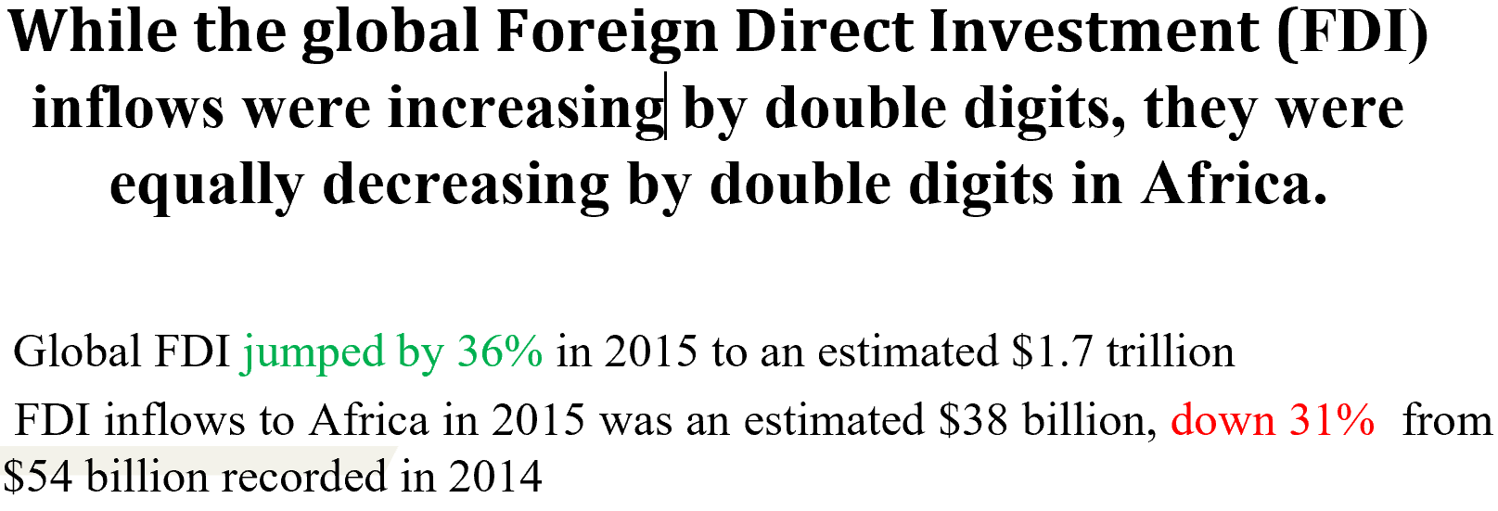
Problem of Practice
4.
1.
Understanding the complexity of Foreign Direct Investment decision factors from investors perspectives
Problem of Practice
2.
Project Question
How and to what extent do the investor’ perception of investment promotion and facilitation services and experiences influence their decisions?

Slide 5
Project Motivation and Goals
Motivation 1
Quest to better understand the investors’ perception of essential factors of investment decisions, and the influential roles of the apex Investment Promotion Agency (IPA) controlling those perceivable factors for beneficial Foreign Direct Investment.
Motivation
2
The need to understand whether Invest. promotion and facilitation moderates potential investor; decision to invest
To assess the role of investors’ inherent risk preferences that can be explained by individual and situational differences and how they influence the propensity to engage in FDI.
Overall Goal

Slide 6
Problem of Practice
Use R to analyze the dataset from an online survey of 260 foreign investors in Sub-Saharan Africa and the diaspora with the aim to ascertaining and establishing inferences on the FDI.
3.
Methodology
4.
4.
Unit of Analysis
The Individual Foreign Investors

Slide 7
Details of Solution
FDI prediction by moderated predictors using Naïve Bayes Classifier
LEVEL 4
LEVEL 3
Interactive (Moderated) predictors on the Vector (FDI)
Combined select predictors on the Vector (FDI)
LEVEL 2
LEVEL 1
Individual select predictors on the Vector (FDI)

Slide 8
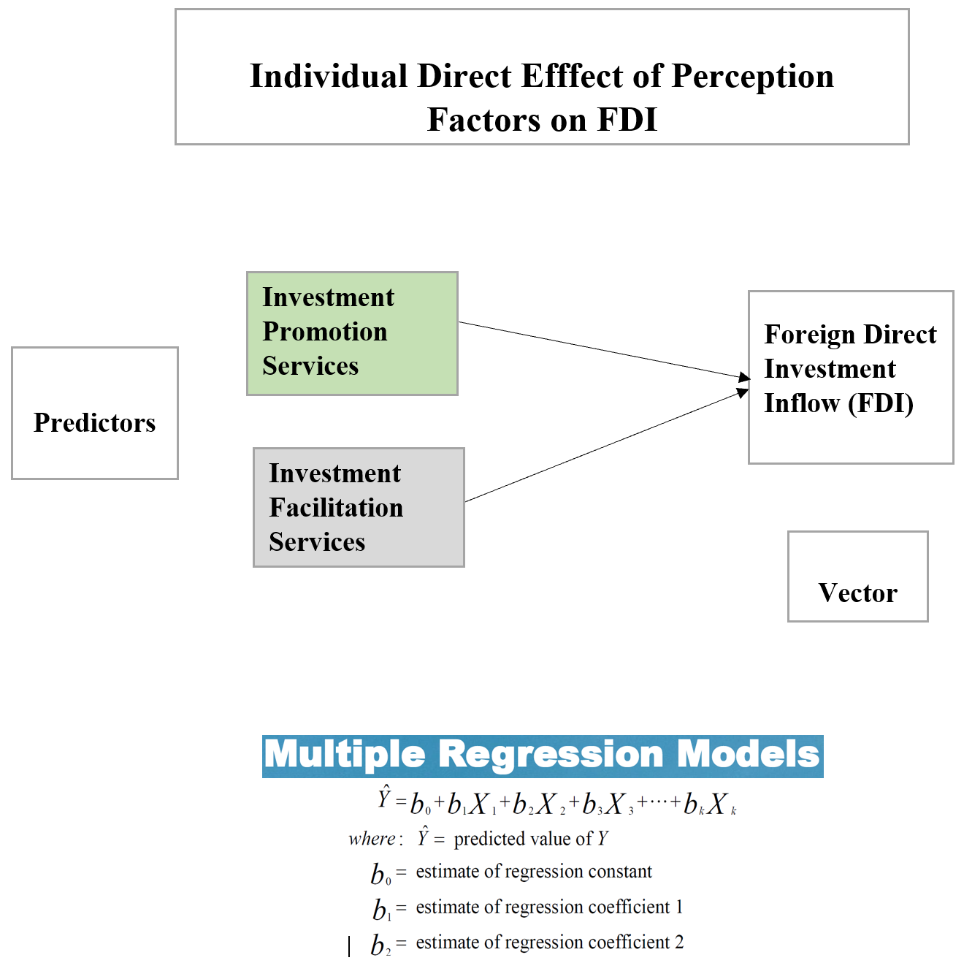
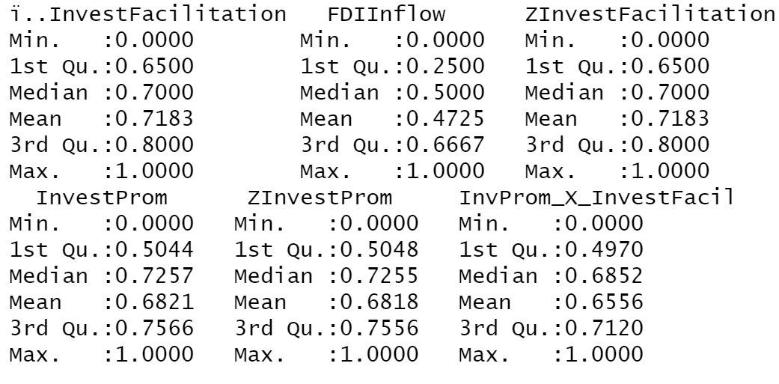
Model 1 & 2
4.
Normalized Variables

Slide 9
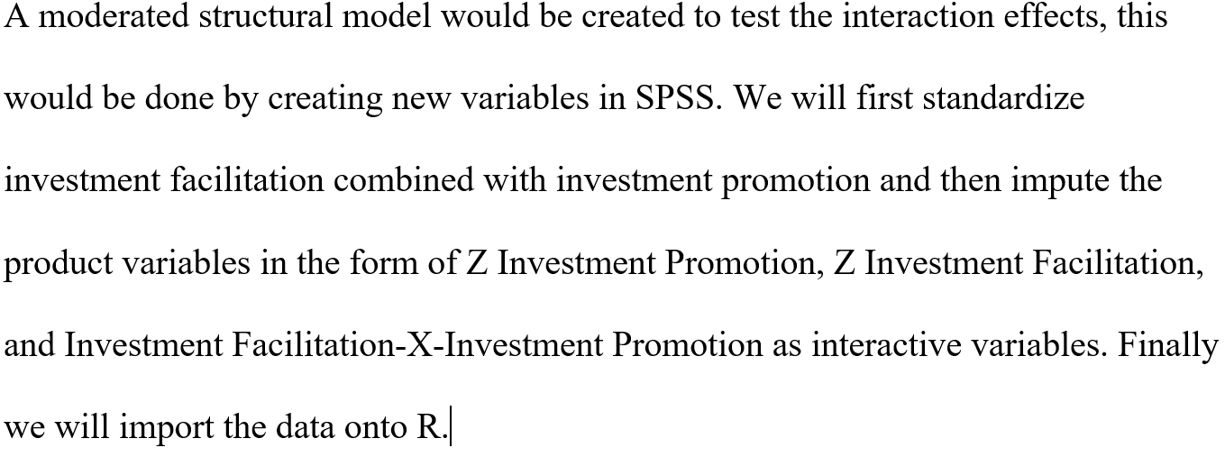
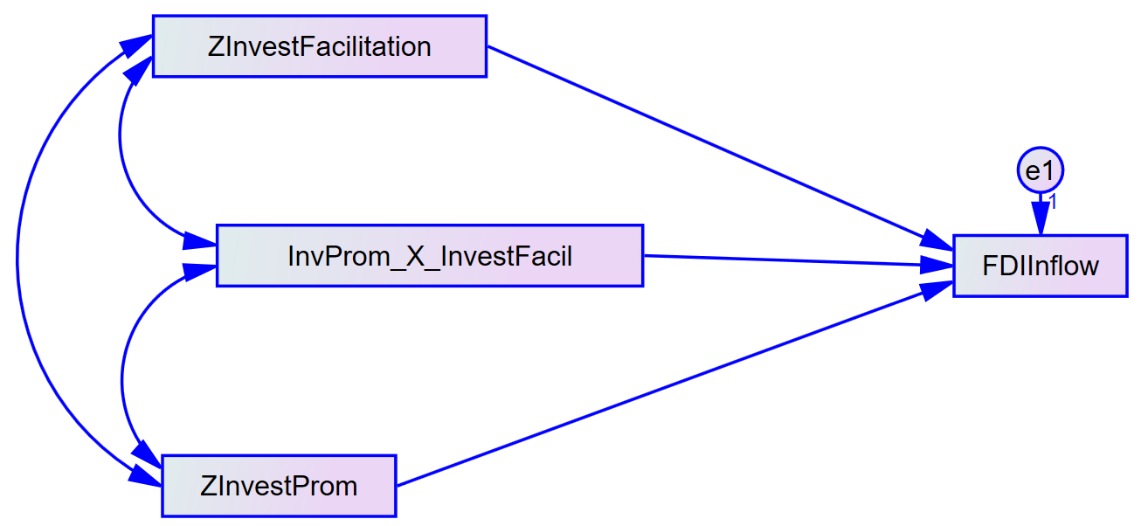
Model 3
4.

Slide 10
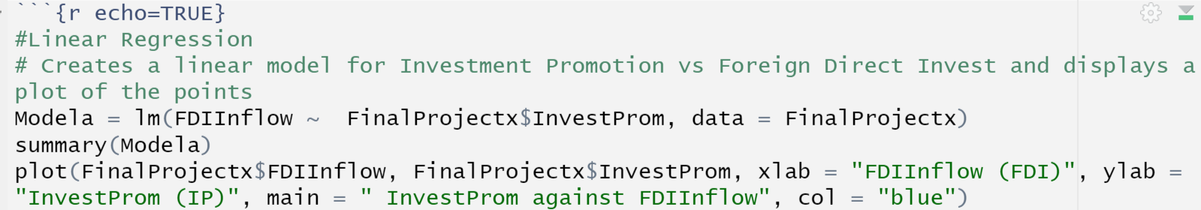
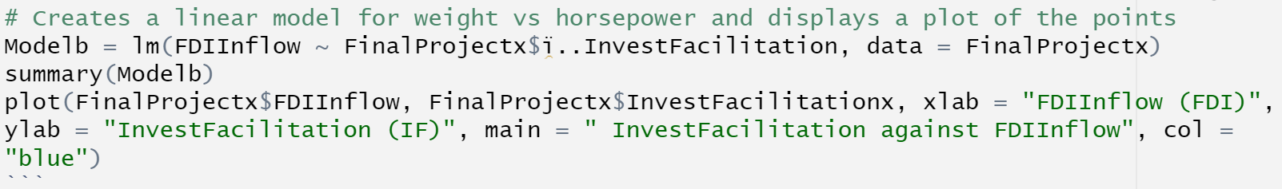
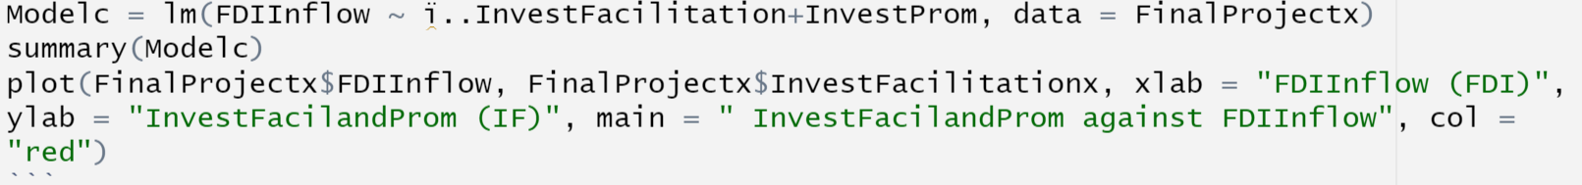
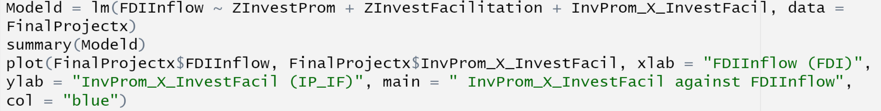
Formula

Slide 11
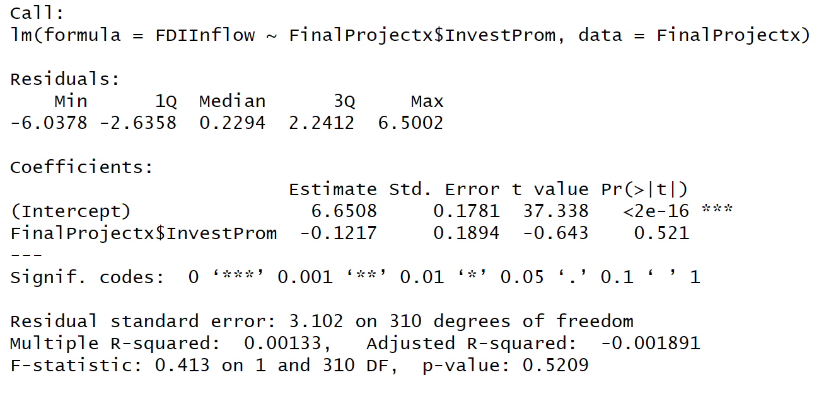
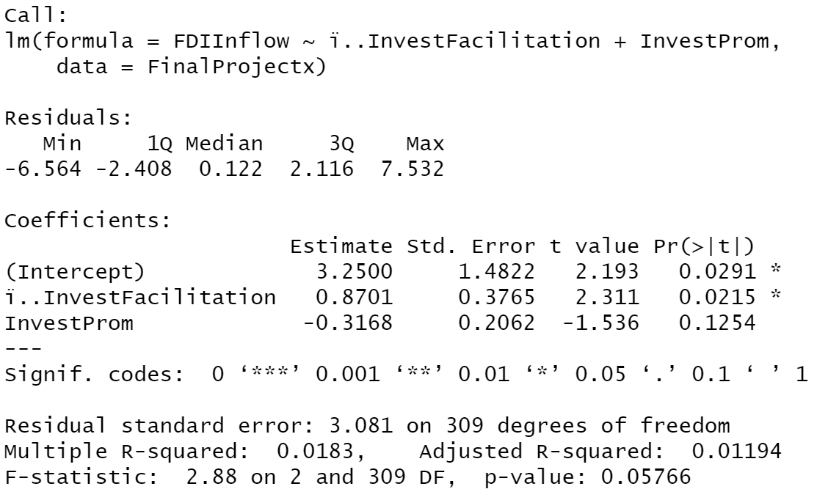
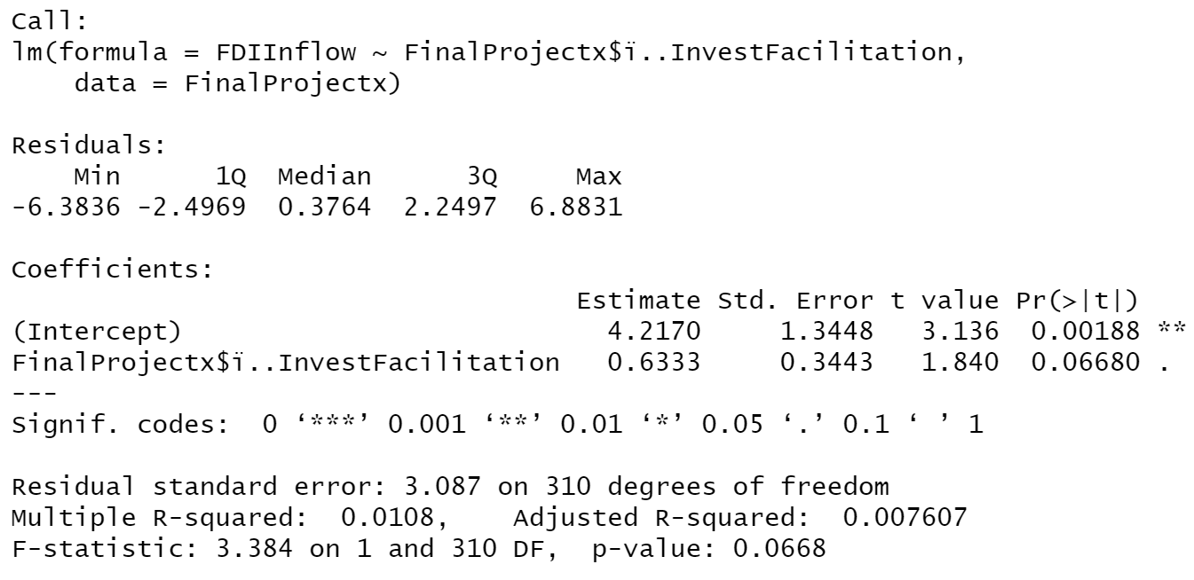
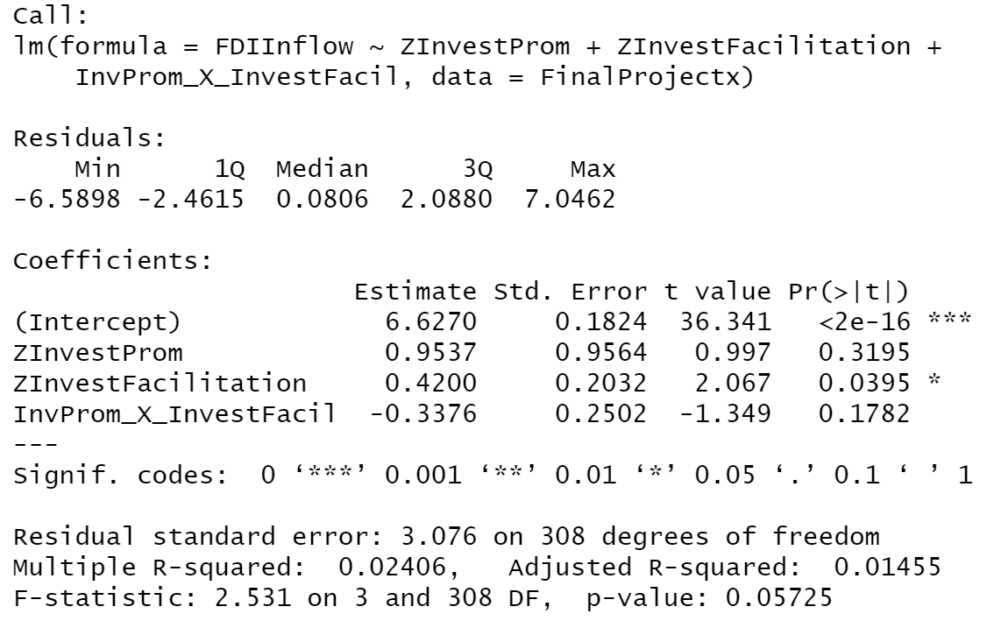

Slide 12
From this linear model we can see that Investment Promotion Services results in a model that the P value is insignificant 0.52, and that it accounts for 0.13% of the variation in Foreign Direct Investment Inflow.
From this linear model we can see that Investment Facilitation Services results in a model that the P value is almost significant 0.067, and that it accounts for 1.08% of the variation in Foreign Direct Investment Inflow.
The linear model that contains both Investment Facilitation and Investment Promotion, this time we have a highly significant P value of IF which is 0.022, and we see that the total model accounts for 1.83% of the variability in FDI Inflow.
The linear contains the standardized (Z-score) of both Investment Facilitation and Investment Promotion and Investment FacilitationXInvestment Promotion, we have a highly significant P value of ZIF (0.039). Although the result indicates there was a non-significant interaction effect (P-value = 0.178) of FacilitationXInvestment. However, we may still consider meaningful moderation to be present (Hayes 2013, Matthes and Jorg 2020) Johnson-Neyman Plot. It could also be seen that the total model accounts for 2.4% of the variability in FDI Inflow.

Slide 13
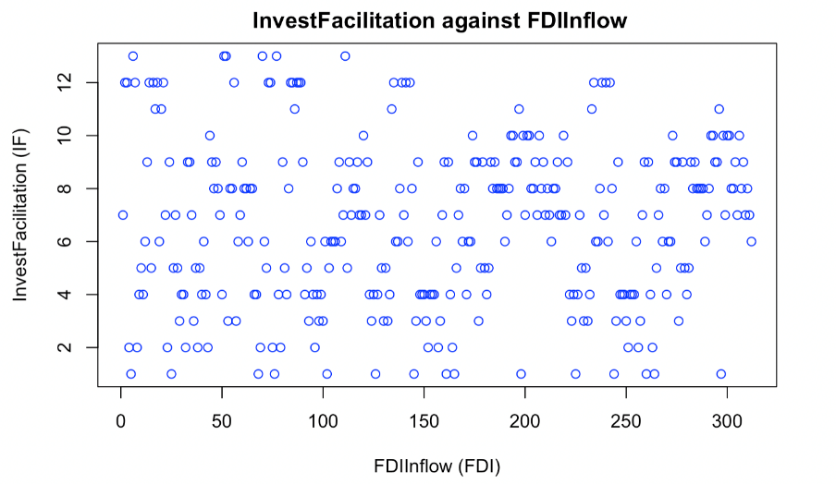
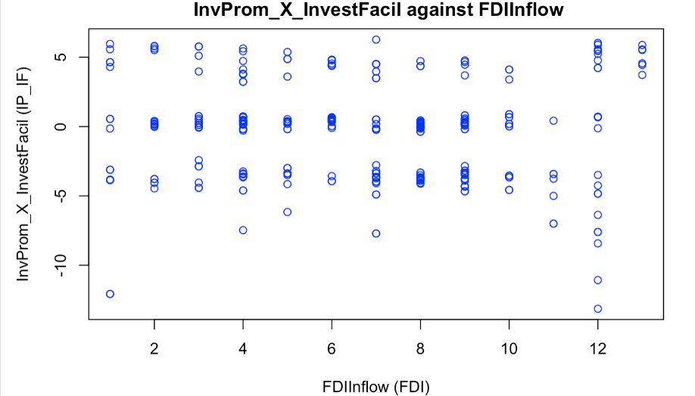
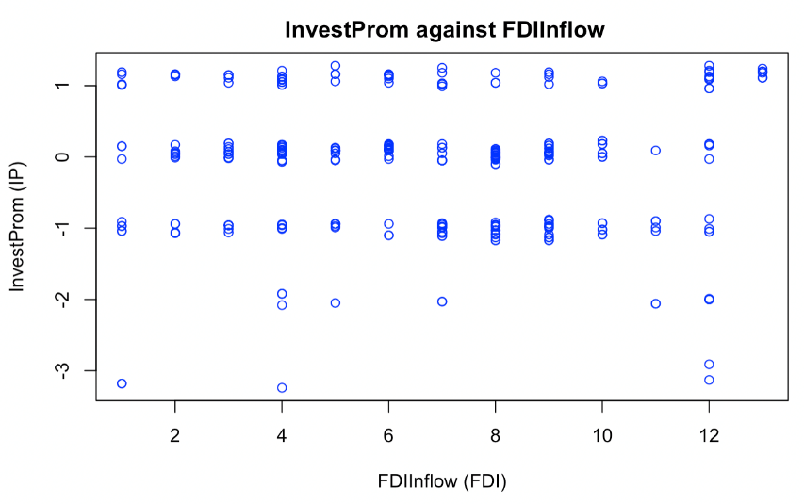
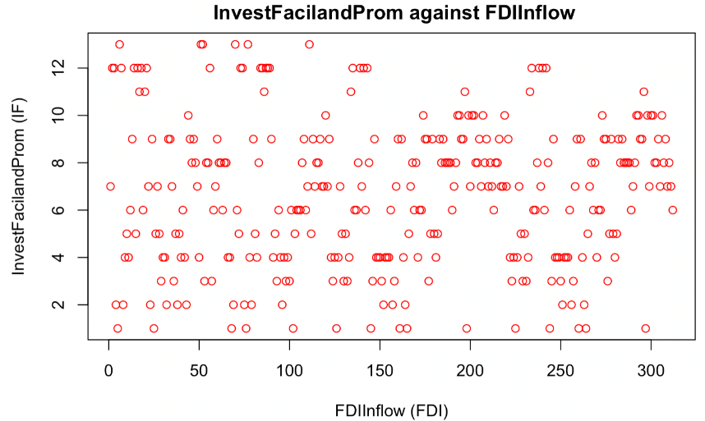
Findings Summary
PLOTS OF ALL THE LINEAR MODELS

Slide 14
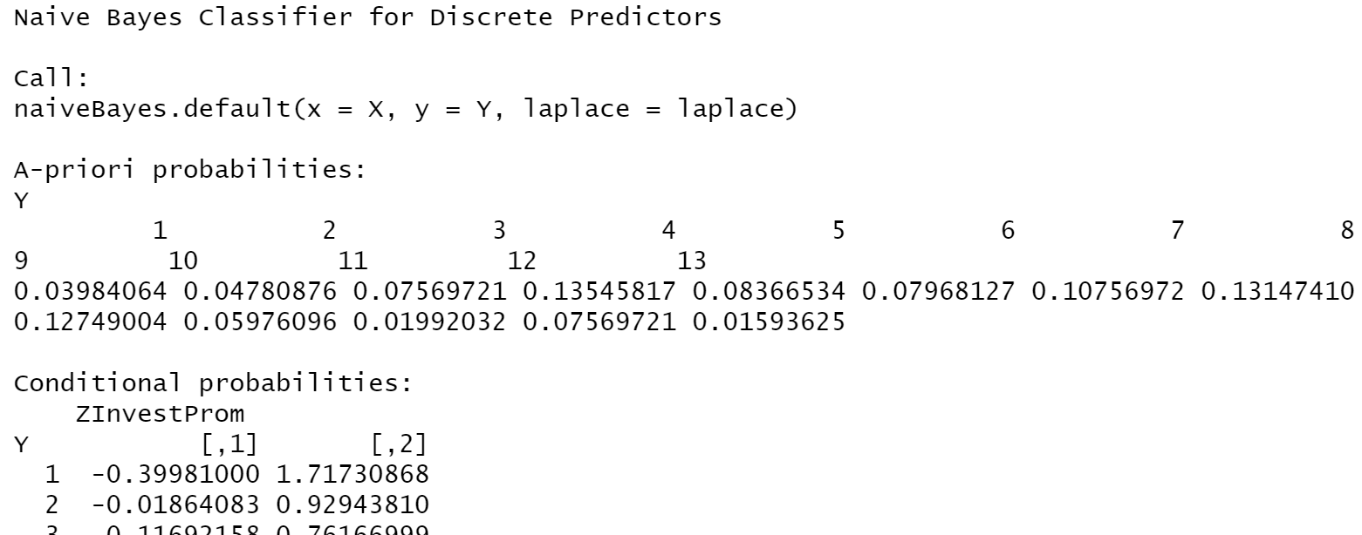
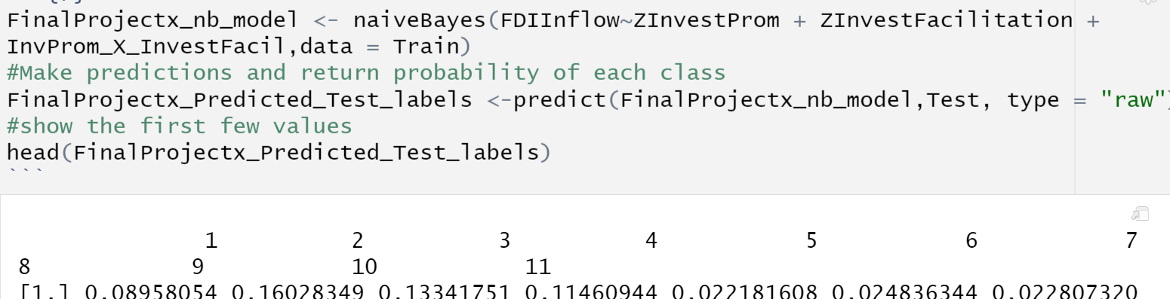



Naïve Bayes

Slide 15
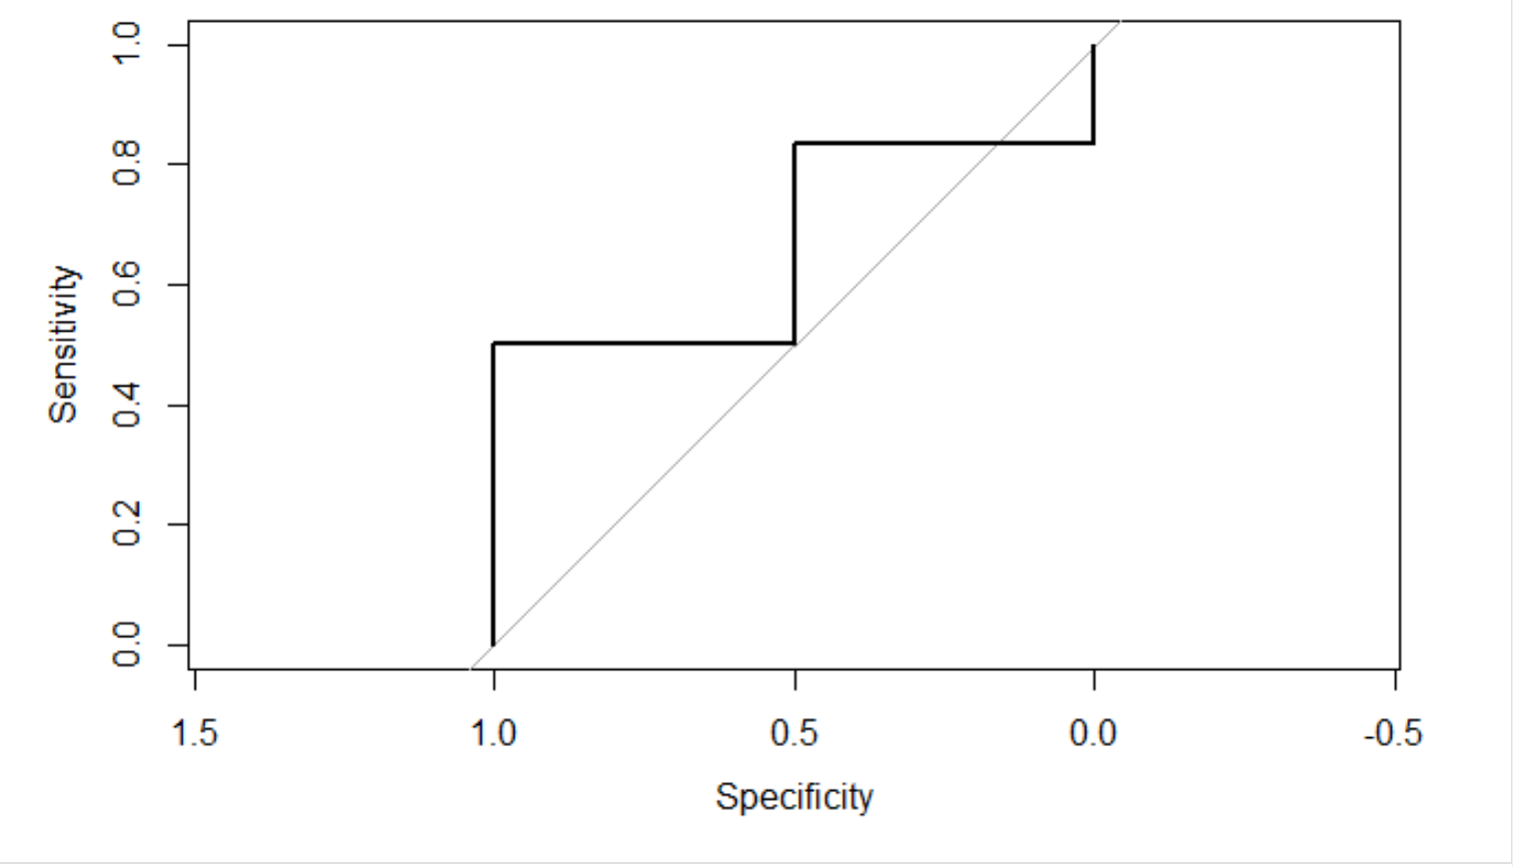
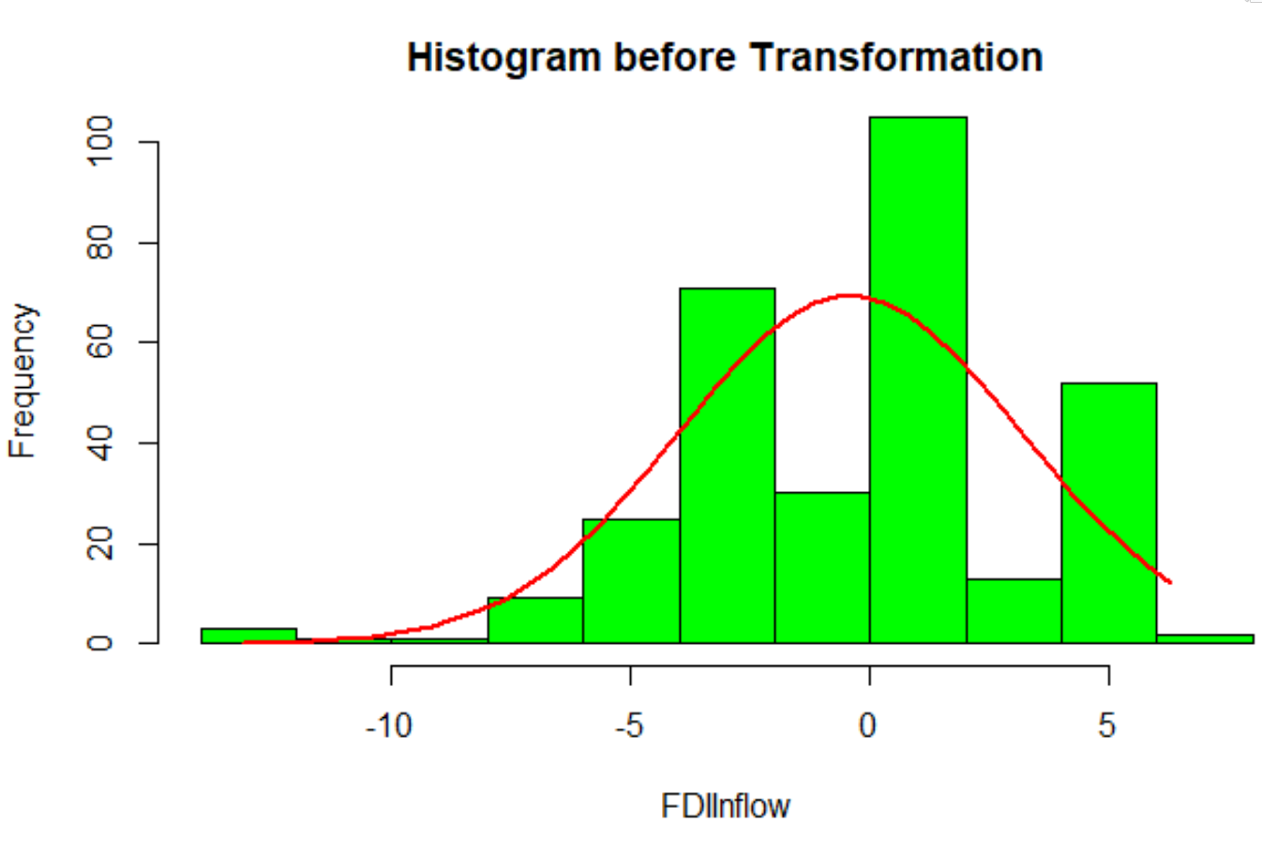
The output of the ROC curves
The AUC here is 0.6667. The ROC curve is plotted such that the X- axis is Specificity (True Negative Rate), rather than 1- specificity (False Positive Rate). This function can be thought as plot of FDI, which is a type 1 error of decision rule.

Slide 16
